Slide 1
Creating a Meaningful Strategic Plan
____________________________________________________________________________
Jane Walton Consulting, LLC
1613 Madison Ave. KCMO 64108
www.janewaltonconsulting.com
816.898.6929

Slide 2
Where your firm is focused, and how it is managed and organized, will significantly impact how your team feels, behaves, and contributes.

Slide 3
“Strategy is about what you are going to do now in order to shape the future to your advantage.” – Stephen Bungay

Slide 4
Your strategic plan will drive your firm’s organization and system design.

Slide 5
Strategic Plan
3-5 years
Operations Plan
annually

Slide 6
Operations Plan
ensure the success of strategic objectives
build a solid business foundation
invest wisely

Slide 7
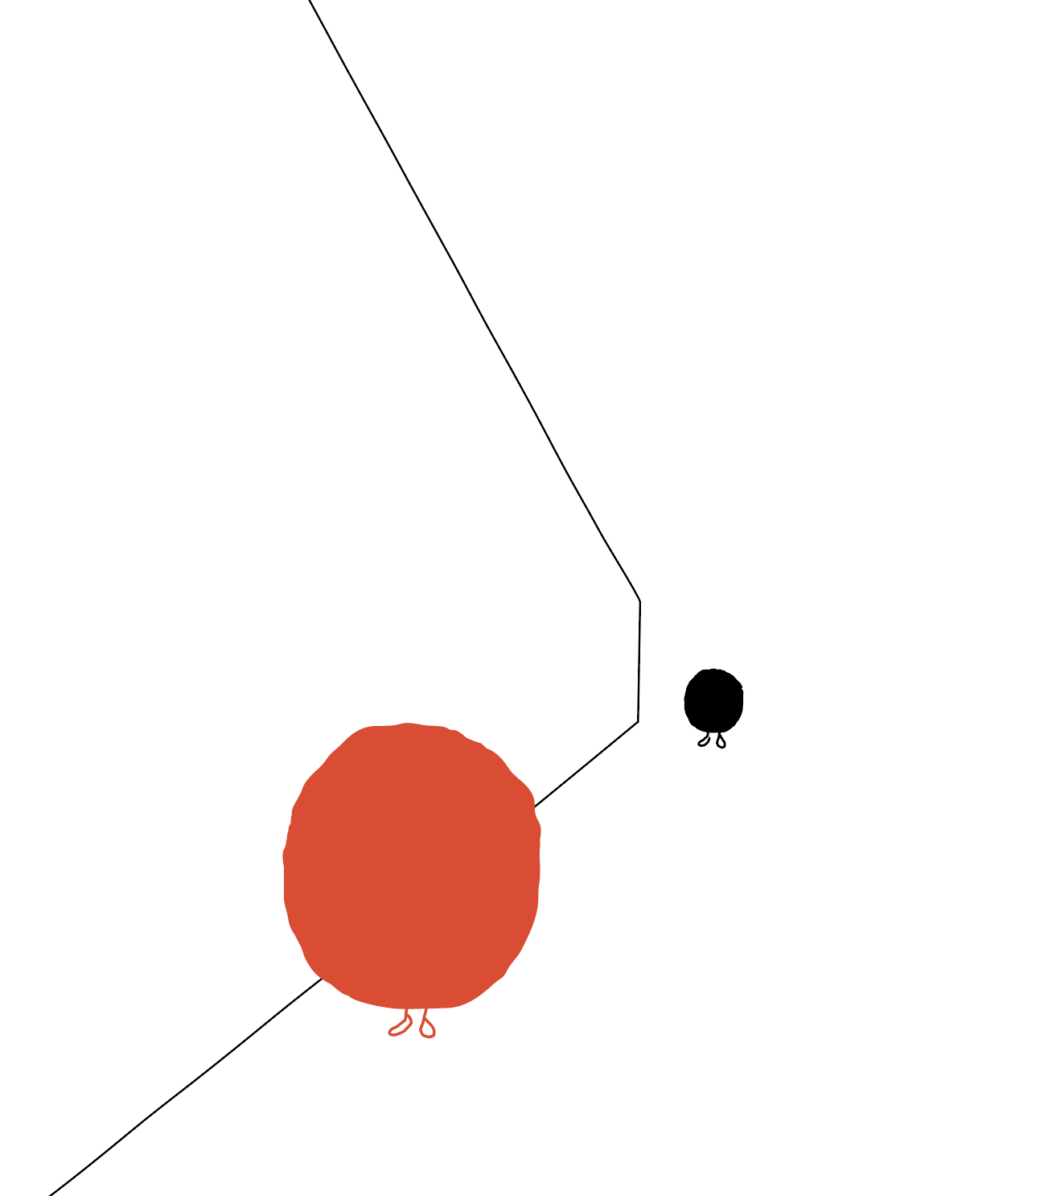
Priority Markets – Intended Impact

Slide 8
Deepen
Increase your level of expertise through R&D and innovation.
Grow
Where you want to increase market share.
Hold Steady
Continue with the current level of time and effort.
Develop
Bring a new market/service into your portfolio.
Stop
A market/service you no longer want to pursue.
Market Focus
Notes:
with the goal of being an expert who stands apart from others. This will require significant investment (marketing, R&D, technology, firm development)

Slide 9
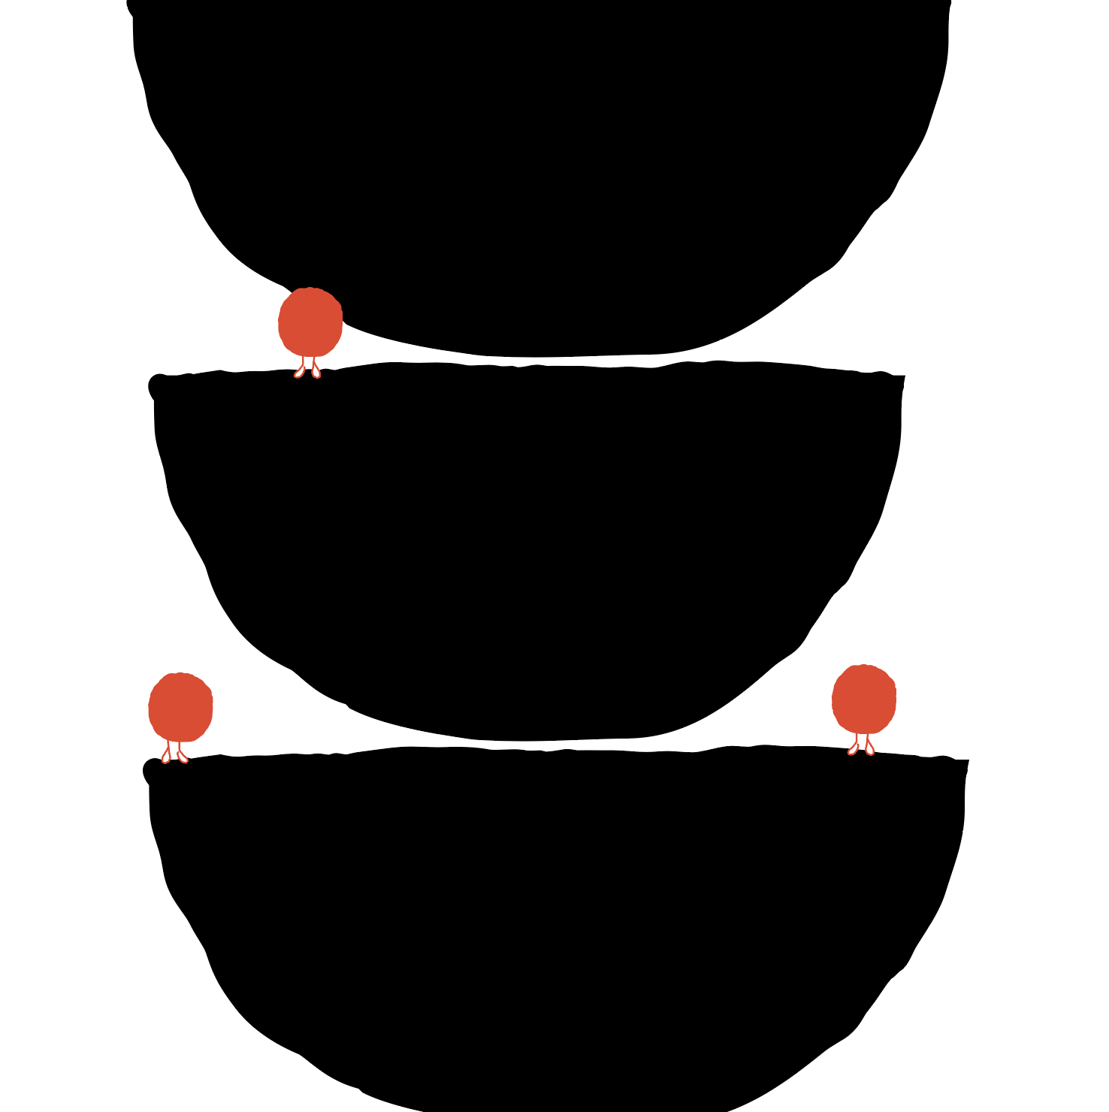
Market Focus
bd strategy
marketing plan
internal development
investment budget

